Slide 1
Detecting COVID-19 via Chest X-rays Using Deep Learning
COMP 4711 Final Project
SUN, Yushi
LI, Tianle

Slide 2
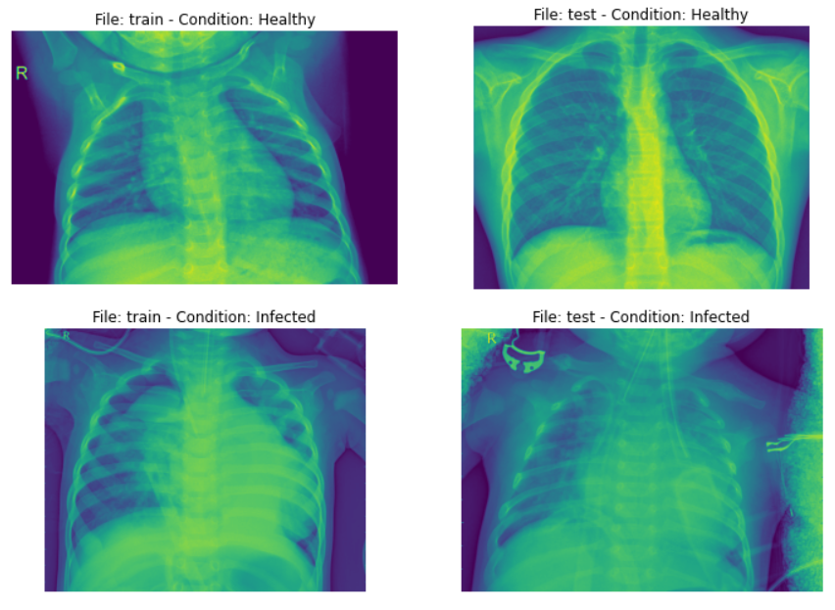
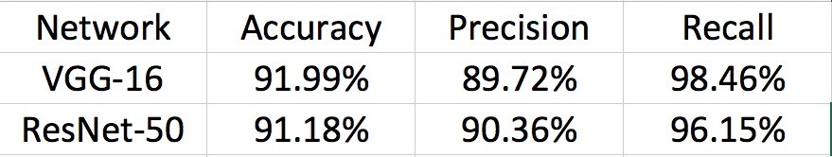
Phase 1
Use transfer learning(applied VGG-16 and Resnet) to train a model to detect pneumonia X-ray scans from healthy scans. (dataset)
Result:

Slide 3
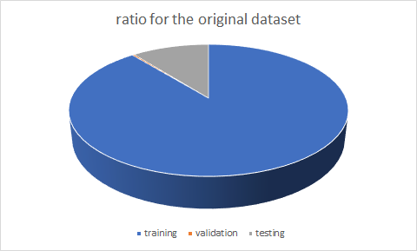
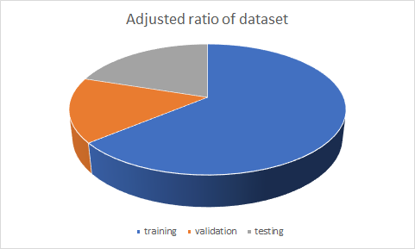
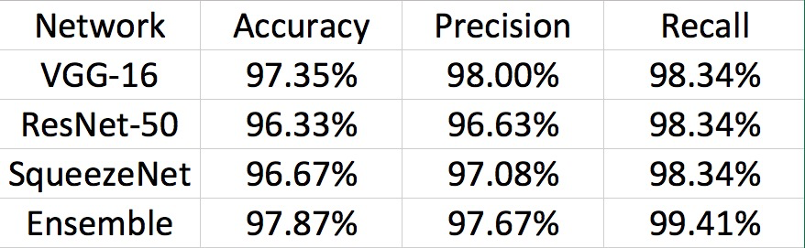
Phase 1 (cont.)
Apply adjustment on the original dataset by changing the ratio of training, validation and testing sets.
Achieve an improved result for VGG-16 and Resnet
Train a model of SqueezeNet on the adjusted dataset
Ensemble VGG-16 and Squeezenet to achieve a better test accuracy

Slide 4
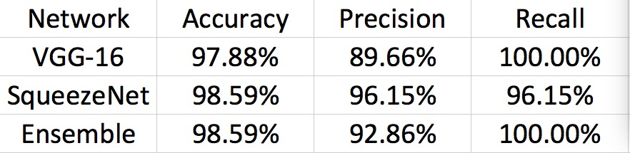
Phase 2
Apply transfer learning for VGG-16 model to classify COVID-19 scans from the pneumonia X-ray scans. (dataset add additional images of bacterial scans and COVID-19 scans from other datasets)

Slide 5
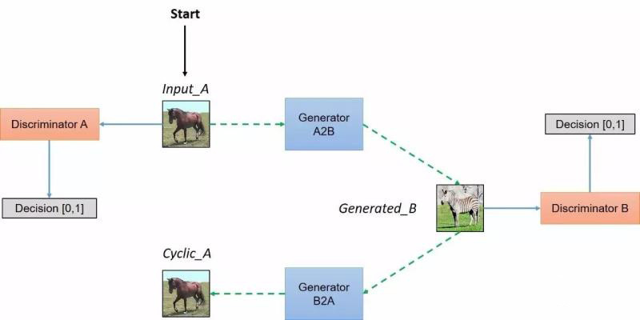
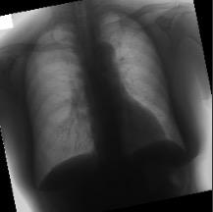
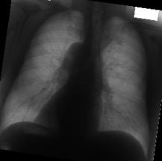
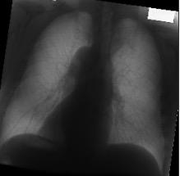
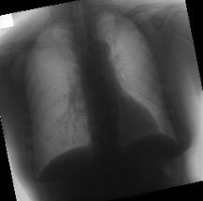
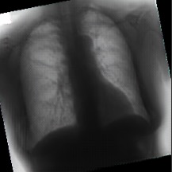
Bone Suppression with CycleGAN
Apply CycleGAN to transfer the original X-ray images into their bone-suppressed version to help doctors for their diagnosis. Suppress the shadow casted by the bones and enhance the quality of X-ray scans.
Original Input
Bone-suppressed

